Slide 1
Symmetric and Asymmetric Cryptography

Slide 2
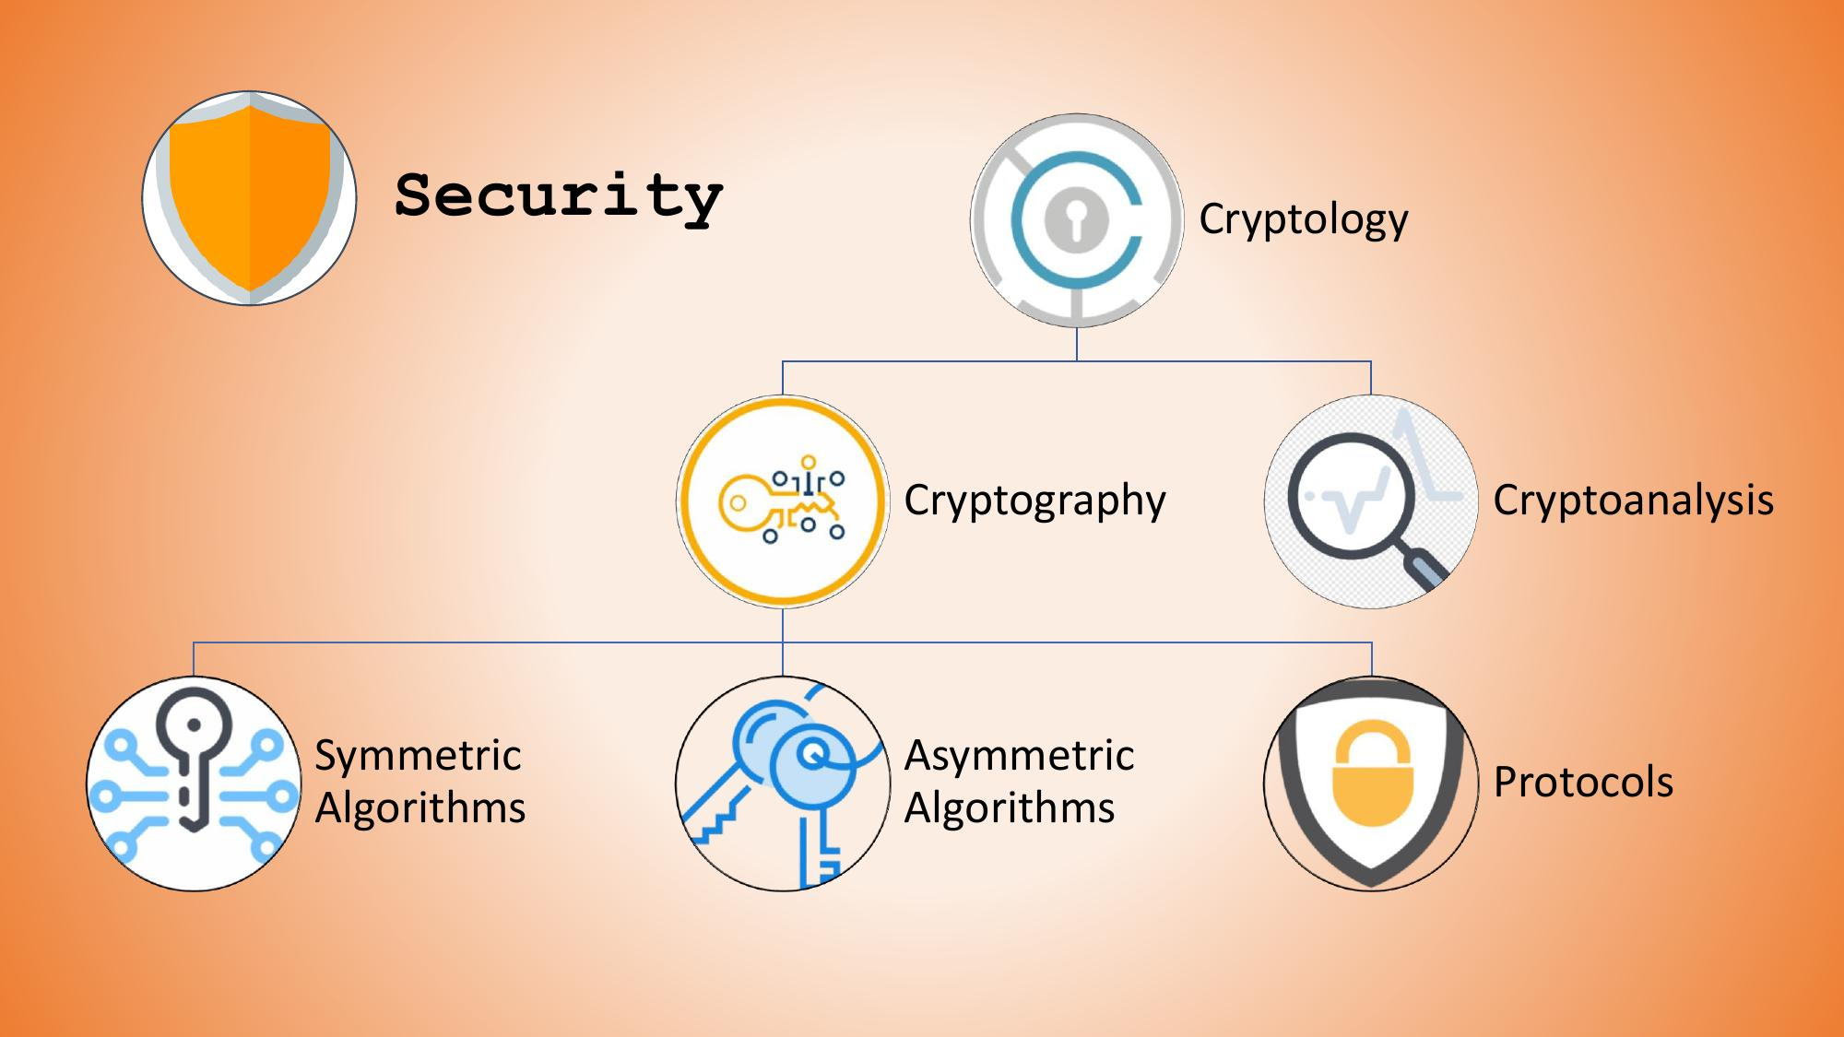
Notes:
Cryptography is the defensive side. We design methods that transform information so that unauthorized people cannot understand it. For example, if Alice wants to send Bob a confidential message, cryptography gives her a way to protect that message.
Cryptanalysis is different. Here, we study how cryptographic systems can be analyzed or attacked. A cryptanalyst may try to discover the plaintext, recover a key, or identify weaknesses in an implementation. So, as cybersecurity students, you should understand both sides. A good security professional should know not only how to build protection, but also how that protection might fail.
The slide also separates symmetric algorithms, asymmetric algorithms, and protocols. An algorithm is the mathematical procedure used for cryptographic operations. A protocol is a broader communication procedure that tells systems how cryptographic operations should be used between parties.
So remember the relationship: cryptography builds the protection, algorithms provide the mathematical mechanisms, protocols coordinate their use, and cryptanalysis tests or attacks those mechanisms. This distinction becomes very useful when we later discuss AES, RSA, and Diffie-Hellman.

Slide 3
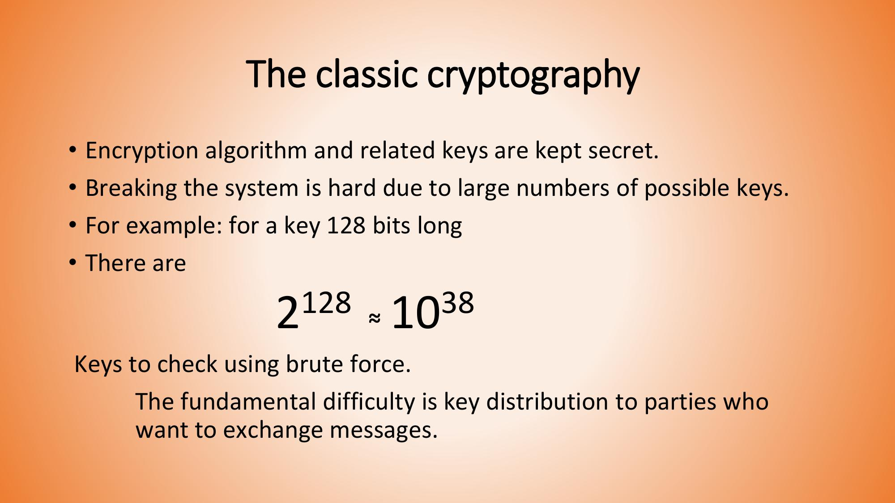

Slide 4
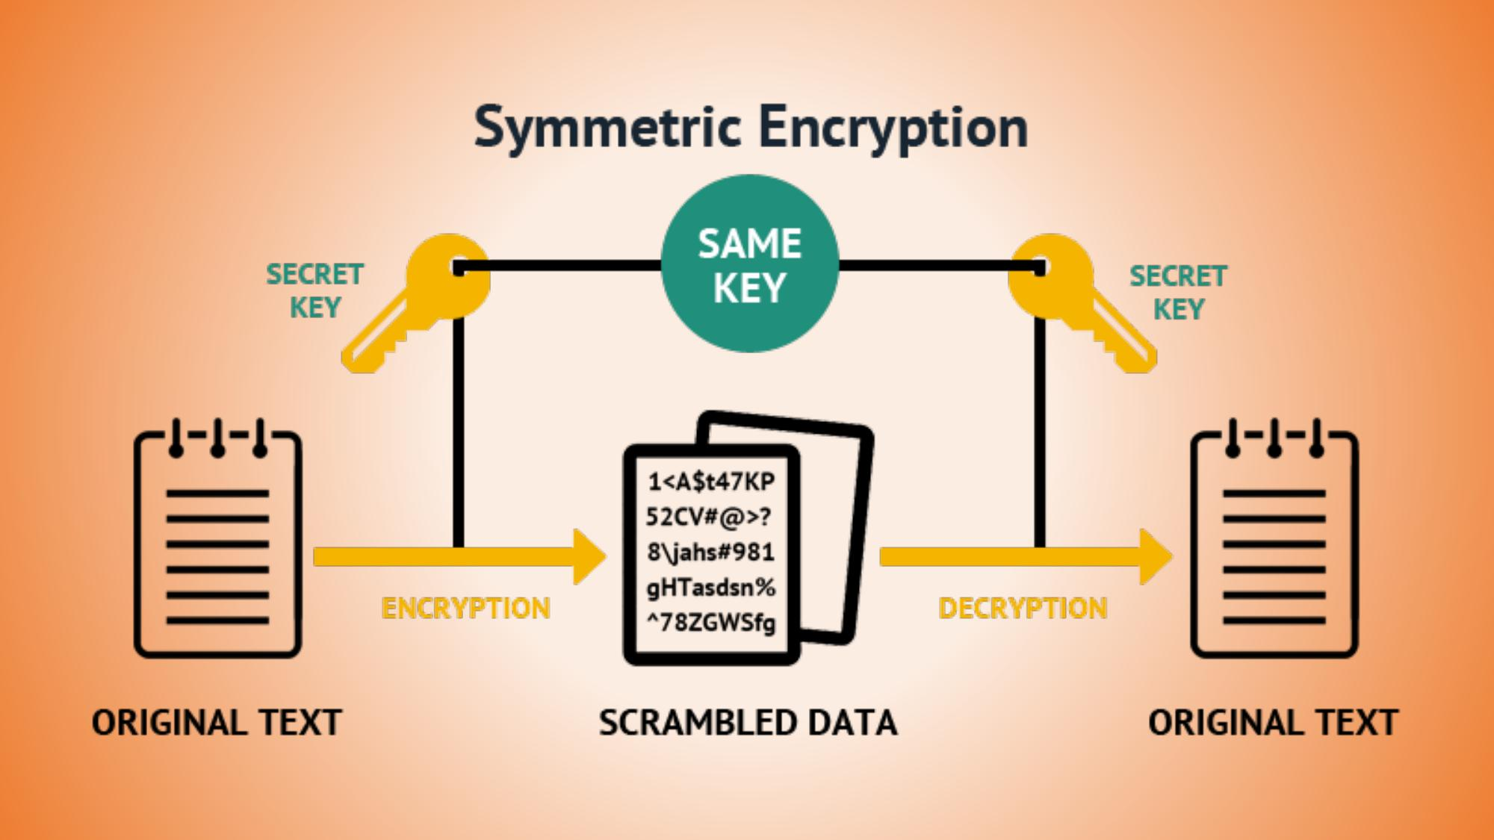

Slide 5
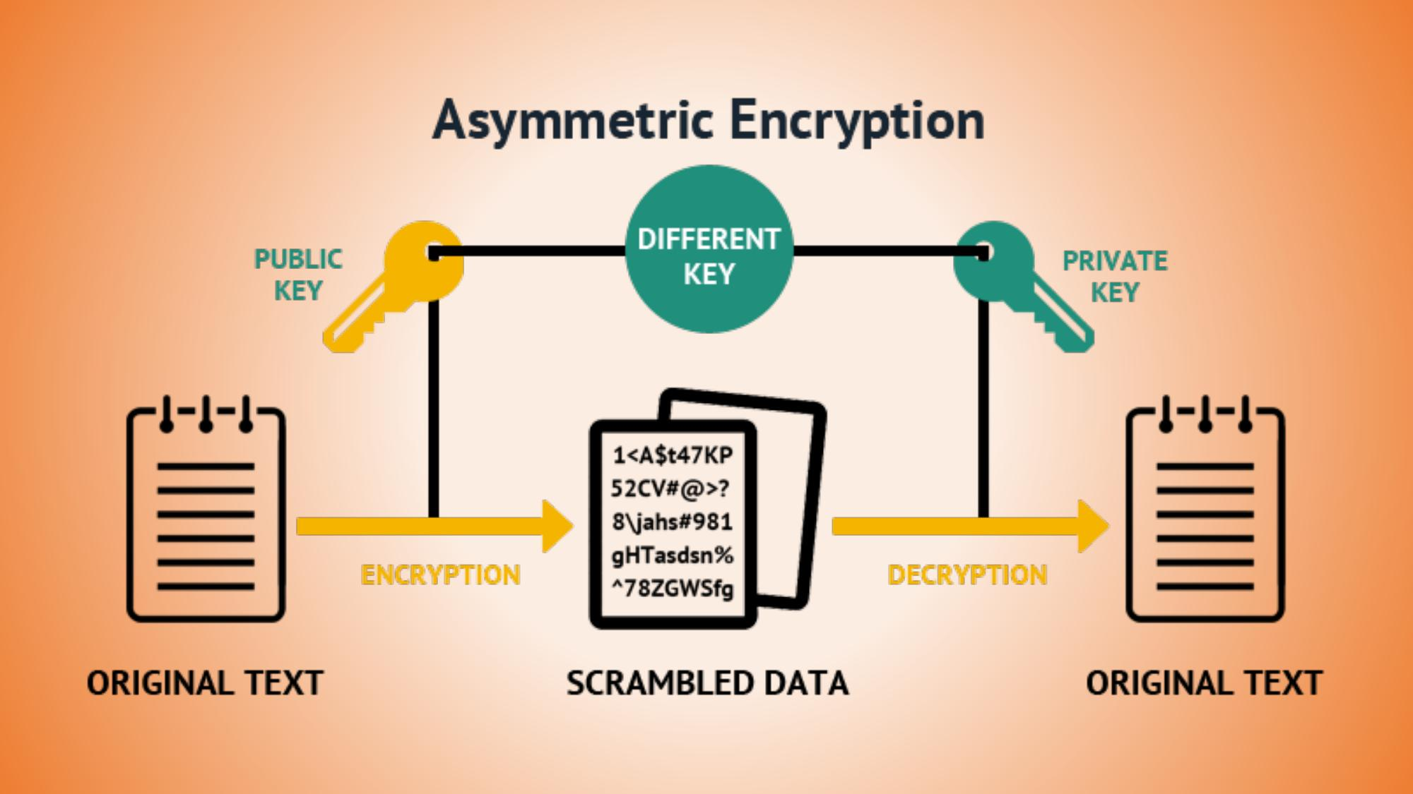

Slide 6
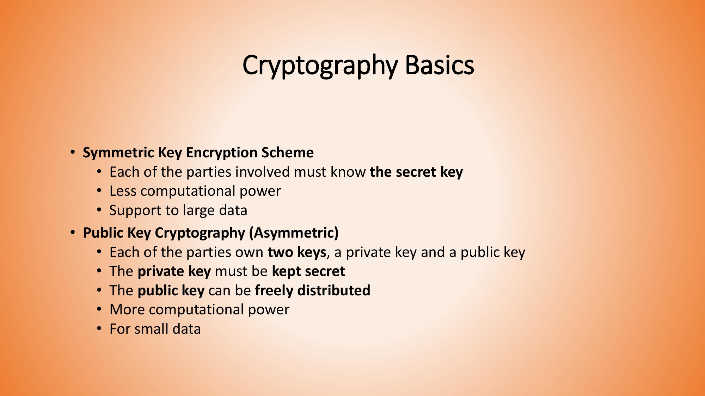

Slide 7
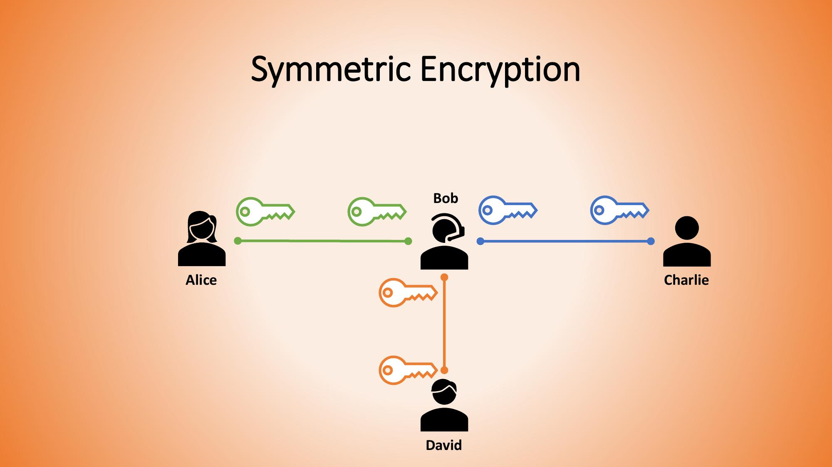
Notes:
This is called a key management or scalability problem. The encryption algorithm itself may be extremely strong, but managing hundreds or thousands of shared keys can become difficult. Think about a university with thousands of students and staff. If every pair of people had to maintain a unique shared secret key, the administrative problem would become huge.
security of the algorithm” and “manageability of the system.” A strong algorithm does not automatically create a convenient secure system. Key generation, storage, distribution, rotation, revocation, and recovery are all part of key management.

Slide 8
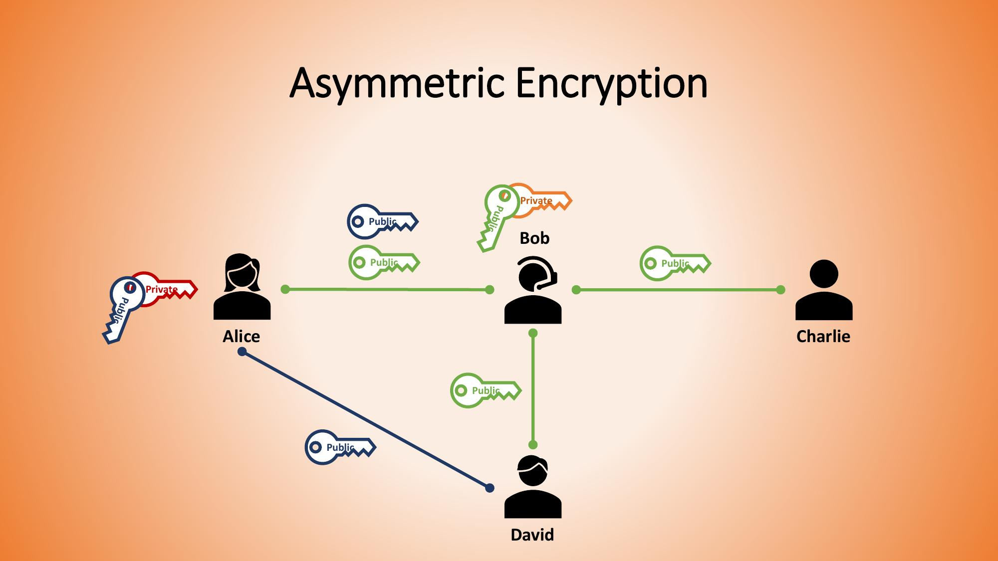
Notes:
But there is an important question: how do Alice and Bob know that a public key really belongs to the person they think it belongs to? Imagine an attacker gives Alice the attacker’s public key and says, “This is Bob’s key.” Alice could encrypt the message for the attacker without realizing it.
This is where authentication mechanisms, certificates, and public-key infrastructure become important. The simple public/private key idea is only one part of a complete security system.

Slide 9
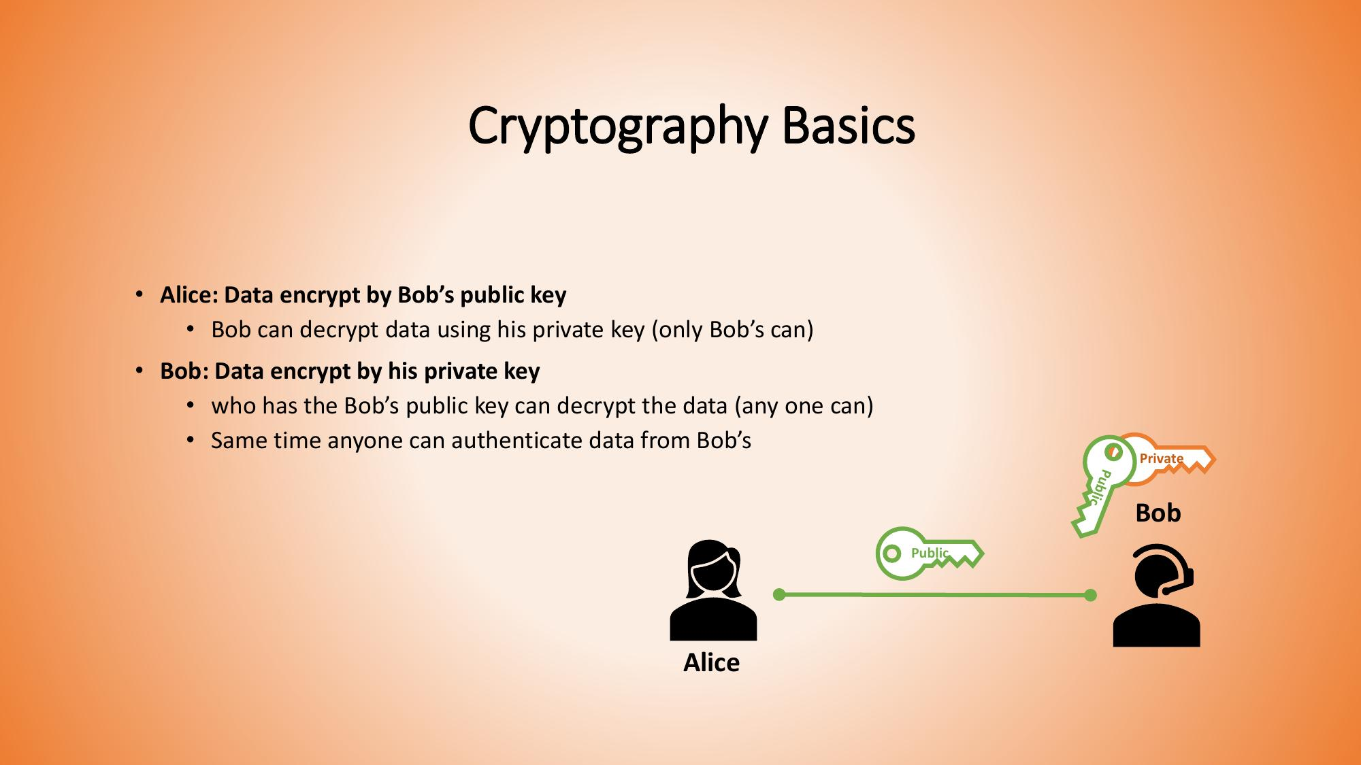

Slide 10
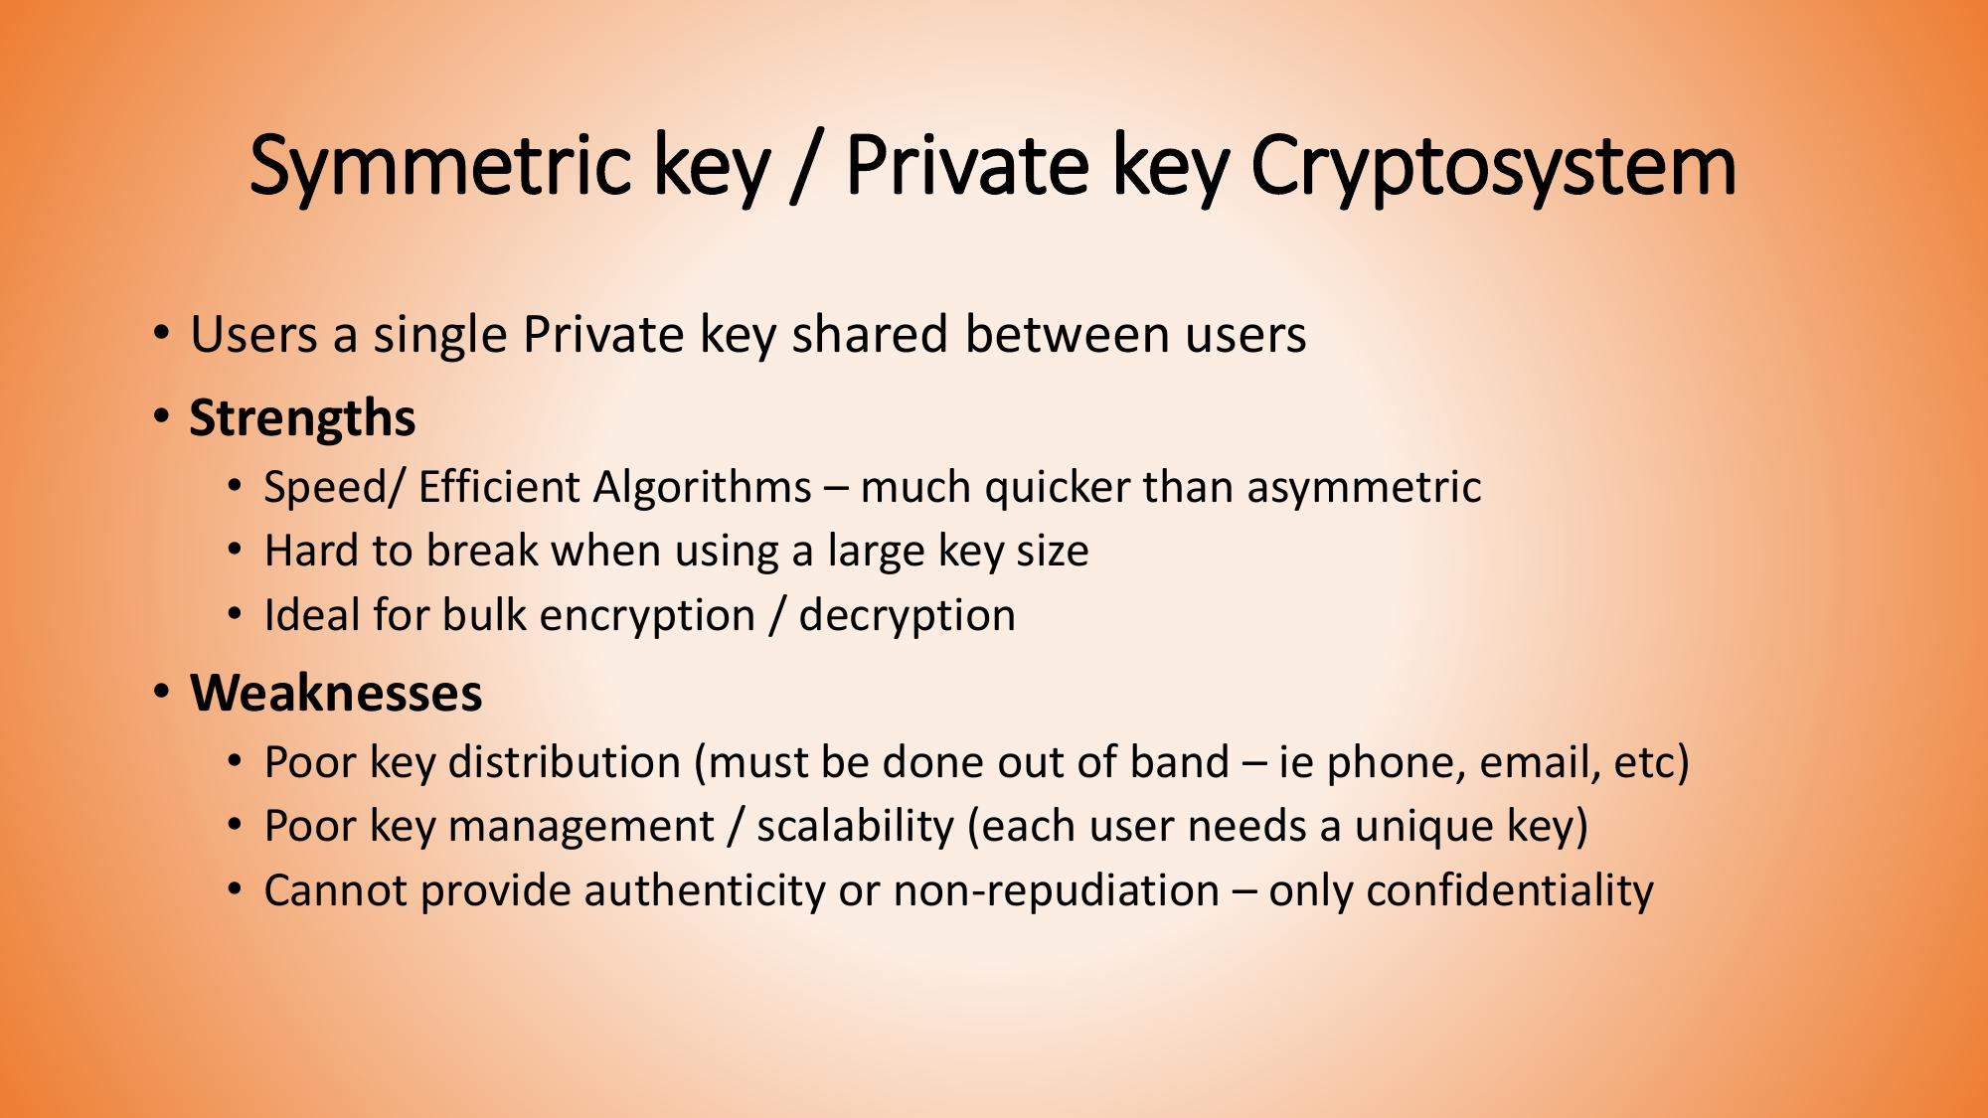

Slide 11
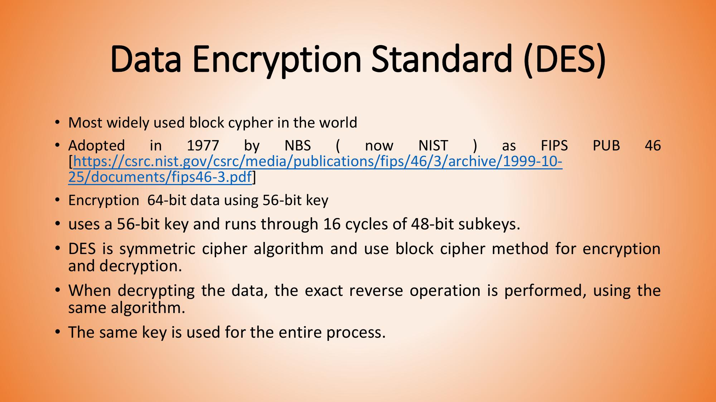

Slide 12
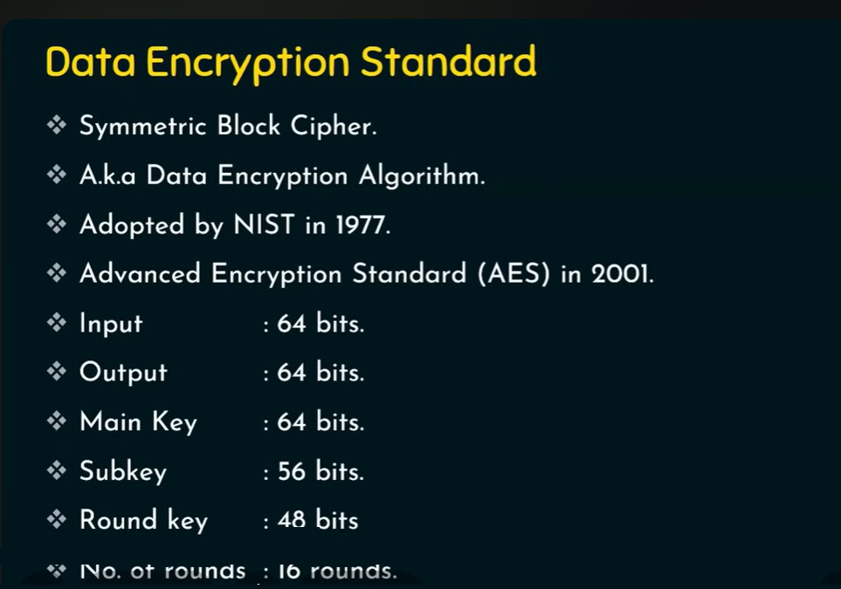
DES at a Glance
DES is a symmetric block cipher (also called the Data Encryption Algorithm), adopted by NIST in 1977 and later replaced by AES in 2001. It processes 64-bit blocks with a 64-bit main key (56 effective bits), derives 48-bit round keys, and repeats its core round function 16 times.

Slide 13
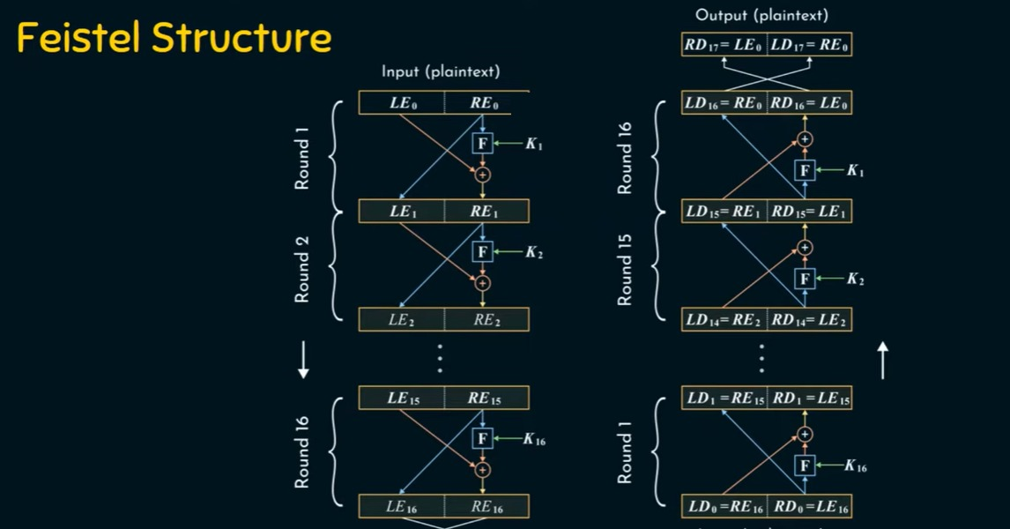
Feistel Structure: Encryption Mirrors Decryption
The same network runs both directions: encryption applies round keys K1 through K16 in order, while decryption applies the identical structure with the keys reversed (K16 down to K1). That symmetry is why a Feistel cipher like DES needs no separate decryption algorithm. The final swap produces the output, LE17 and RE17 - the ciphertext.

Slide 14
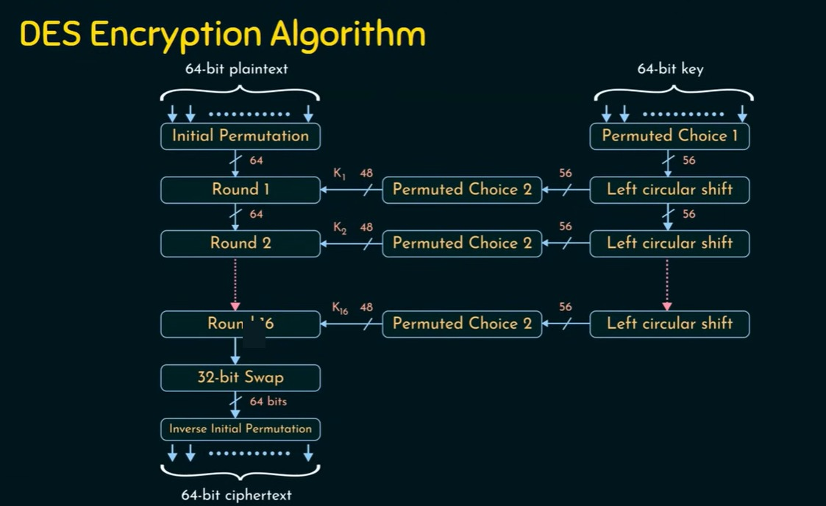
DES Encryption: The Complete Flow
The 64-bit plaintext passes through the Initial Permutation, then 16 rounds, each combined with a round key K1 through K16. Those keys come from a parallel key schedule: the 64-bit key goes through Permuted Choice 1, then repeated left circular shifts and Permuted Choice 2. A final 32-bit swap and Inverse Initial Permutation produce the ciphertext.

Slide 15
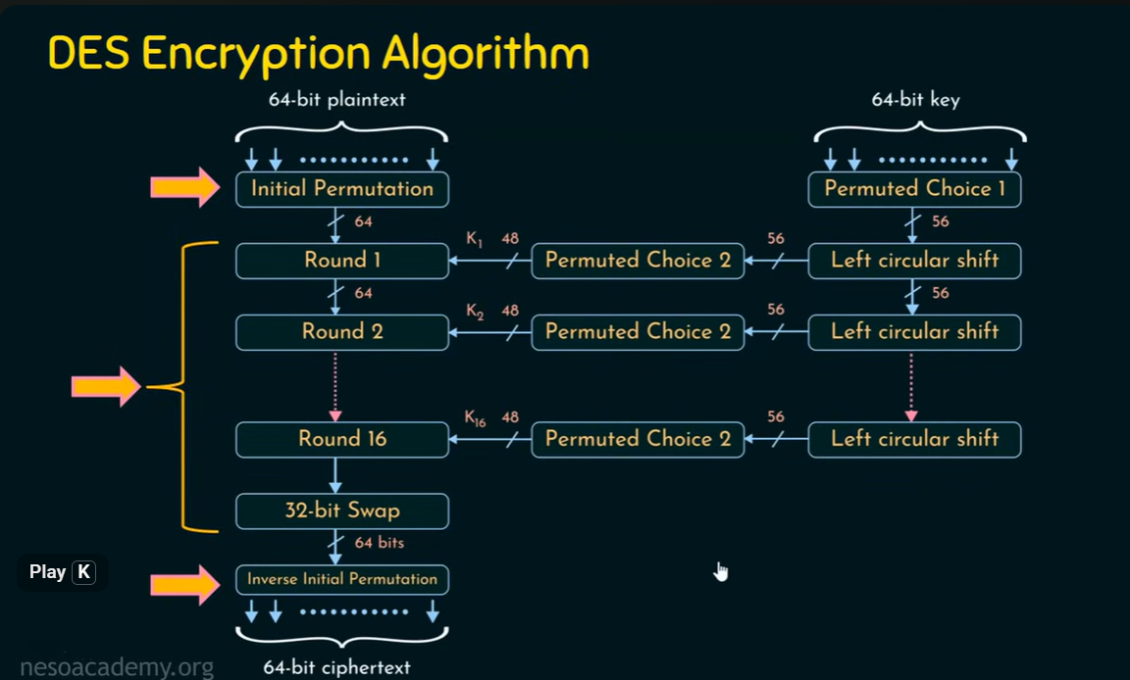

Slide 16
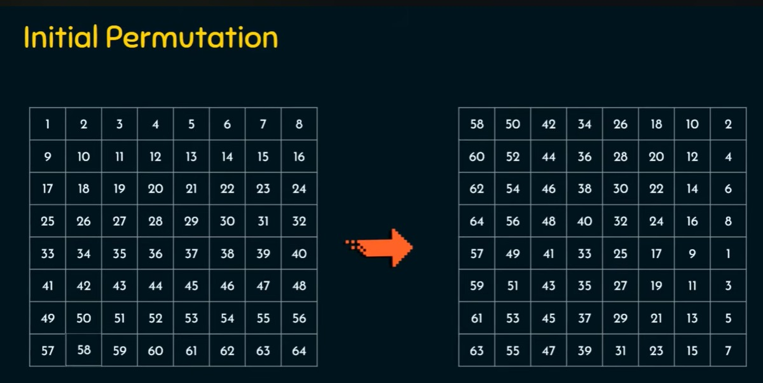
Initial Permutation (IP)
Before round 1, IP rearranges the 64 input bits according to a fixed table: bit position 58 moves to position 1, position 50 to position 2, and so on. Every block is permuted the same way, and the inverse table (IP inverse) undoes it at the very end.

Slide 17
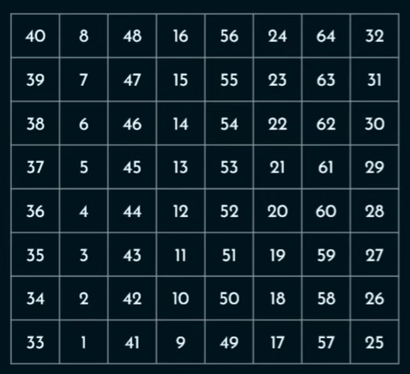
Inverse Initial Permutation
Importantly, IP⁻¹ does not decrypt the data by itself. It only performs the final rearrangement.

Slide 18
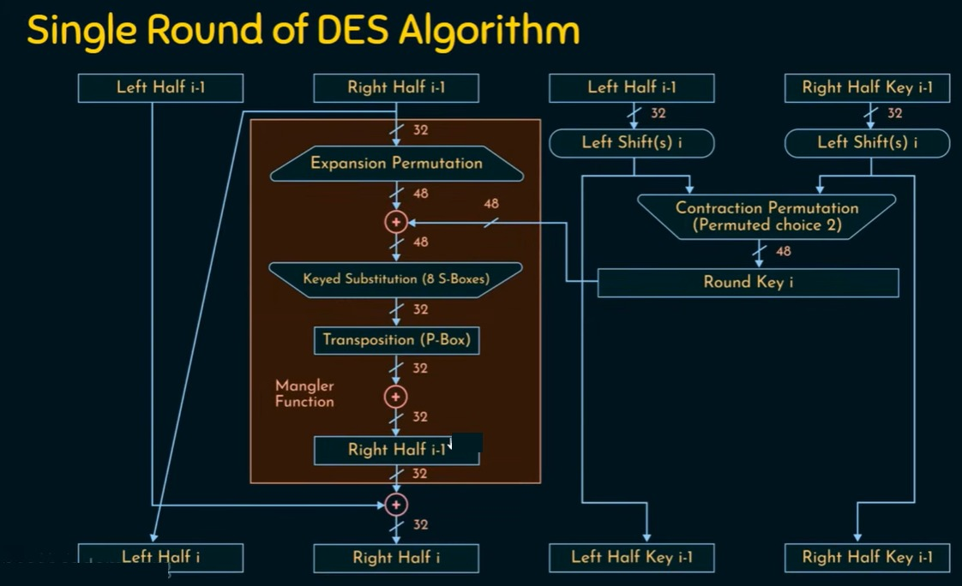
Anatomy of a Single DES Round
Each round splits the block into a left and right half. The right half is expanded from 32 to 48 bits, XORed with that round's key, passed through eight S-Boxes back down to 32 bits, and transposed by the P-Box (together, the mangler function). The result is XORed with the left half to form the next round's right half; the old right half simply becomes the new left half.

Slide 20
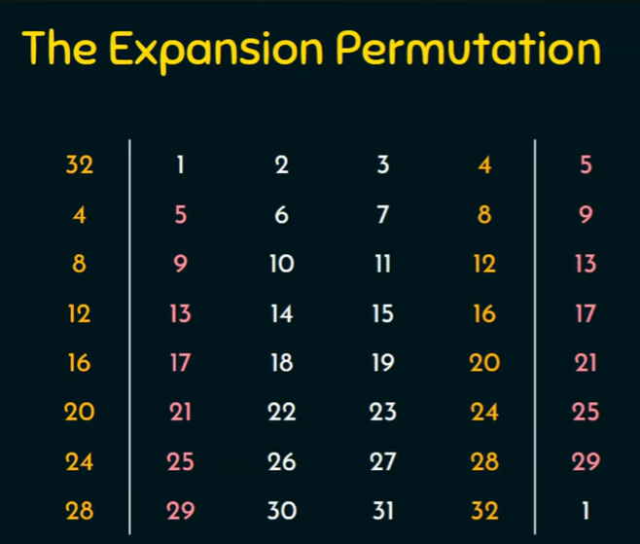
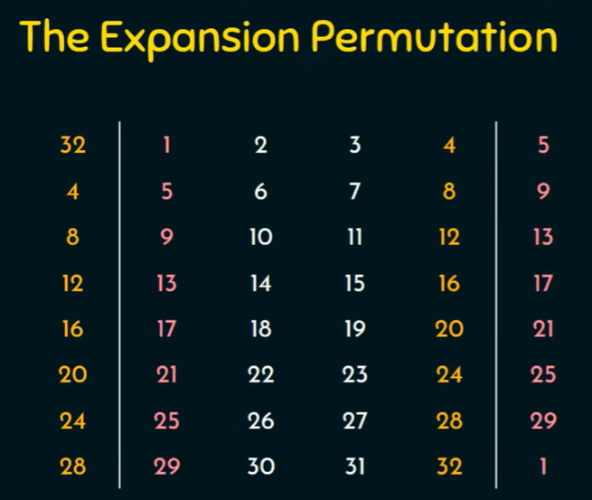

Slide 21
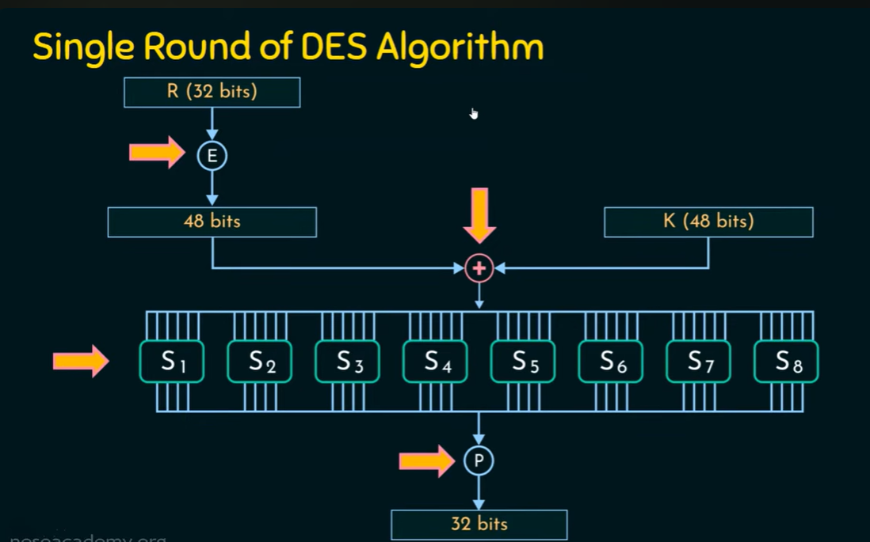

Slide 22
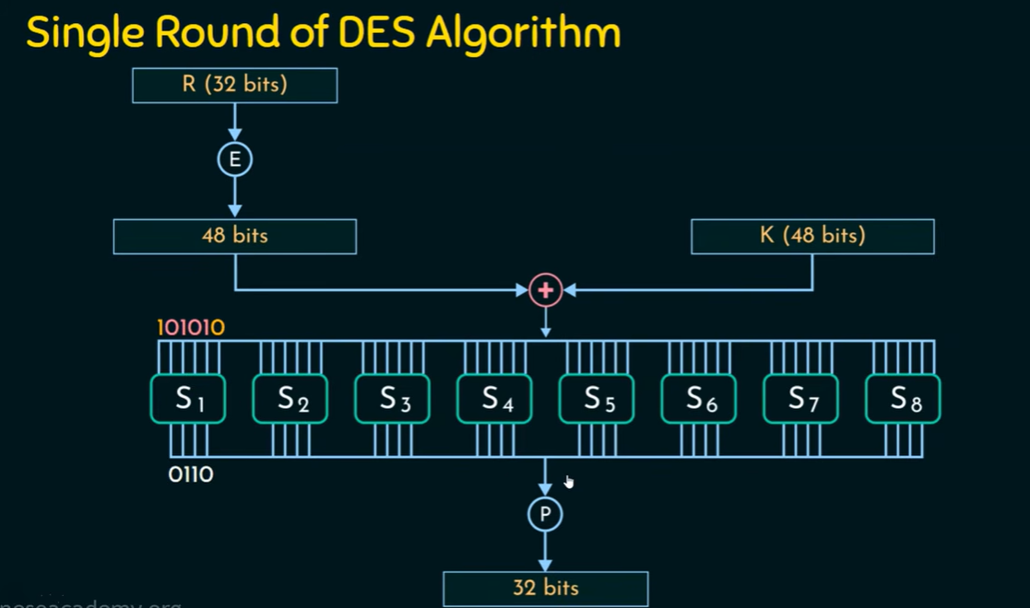

Slide 23
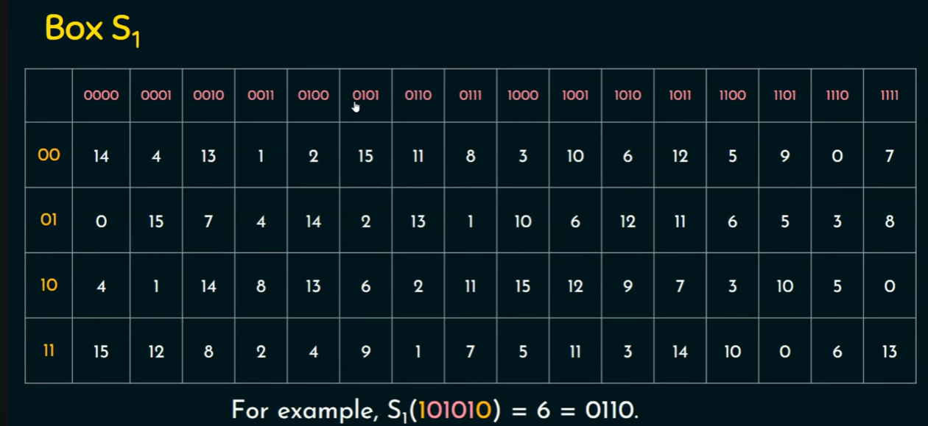

Slide 24
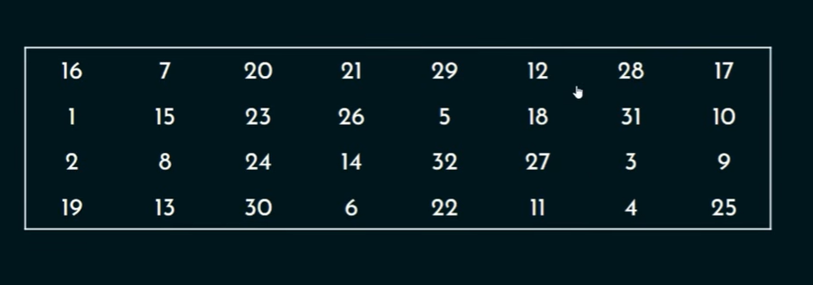
The Permutation Function

Slide 25
AES Algorithm
AES takes readable data + a secret key → performs several mathematical transformations → produces unreadable ciphertext.
What actually happens inside AES?
AES does not simply encrypt one letter at a time. It takes a 128-bit block of data (16 bytes) and performs several rounds of transformations.
For AES-128, there are 10 rounds.
In each round, AES mainly performs:
SubBytes – replaces bytes using a substitution table (S-box)
ShiftRows – rearranges the bytes
MixColumns – mathematically mixes the bytes
AddRoundKey – combines the data with a part of the secret key
The final result is the ciphertext.

Slide 26
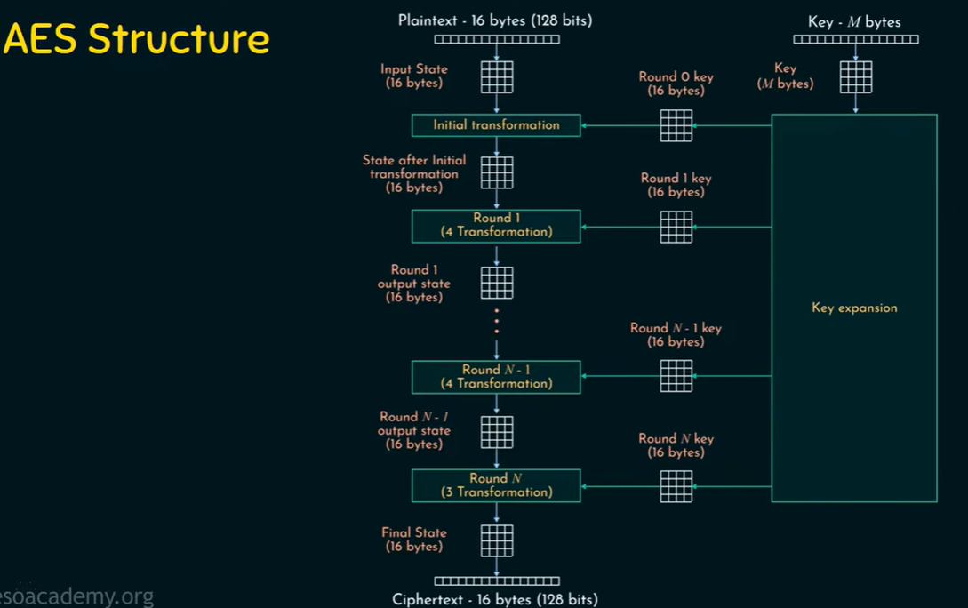

Slide 27
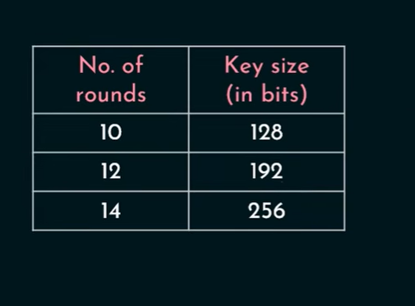
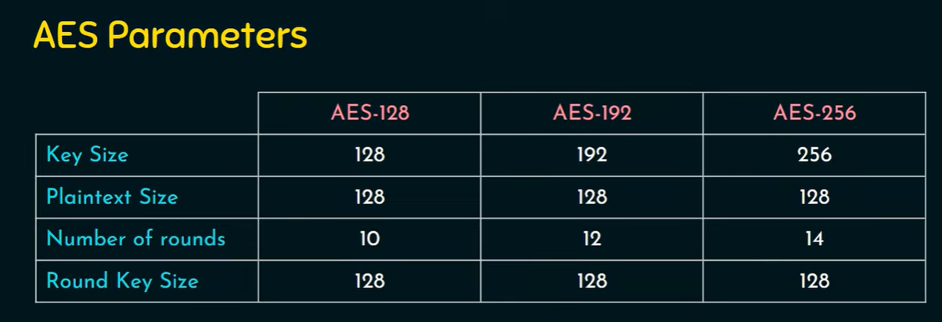

Slide 28
Asymmetric Encryption Algorithms

Slide 29
Diffie–Hellman Key Exchange Protocol (Asymmetric)
Diffie–Hellman (DH) is a cryptographic key-exchange method. Its main purpose is to allow two people/computers to create the same secret key over an insecure network without directly sending the secret key.
The main reason we use Diffie–Hellman is to allow two parties to establish a shared secret key over an insecure network without directly sending the secret key.
Simple example
Imagine Alice and Bob want to communicate securely.
They need a secret key for an encryption algorithm.

Slide 30
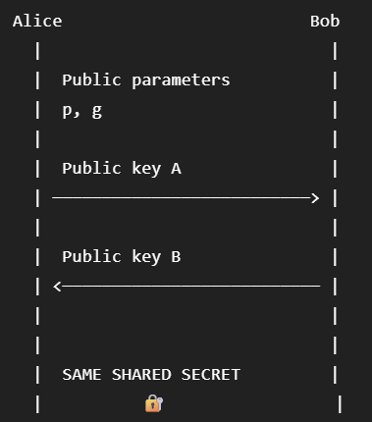
Diffie–Hellman solves the key-agreement problem
Instead of sending the secret key:
Neither Alice nor Bob sends the actual shared secret.
They calculate it independently.
Then the shared secret can be used for encryption

Slide 31
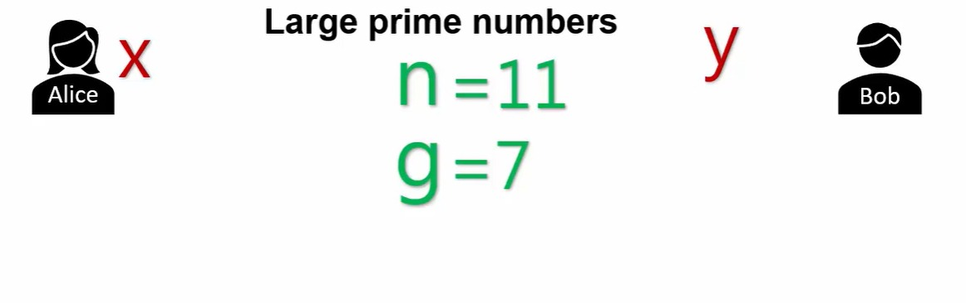
Diffie-Hellman: Setting the Stage
Alice and Bob agree publicly on a prime n = 11 and a base g = 7. Each will also pick a private number of their own (x for Alice, y for Bob) that never gets transmitted over the network.

Slide 32
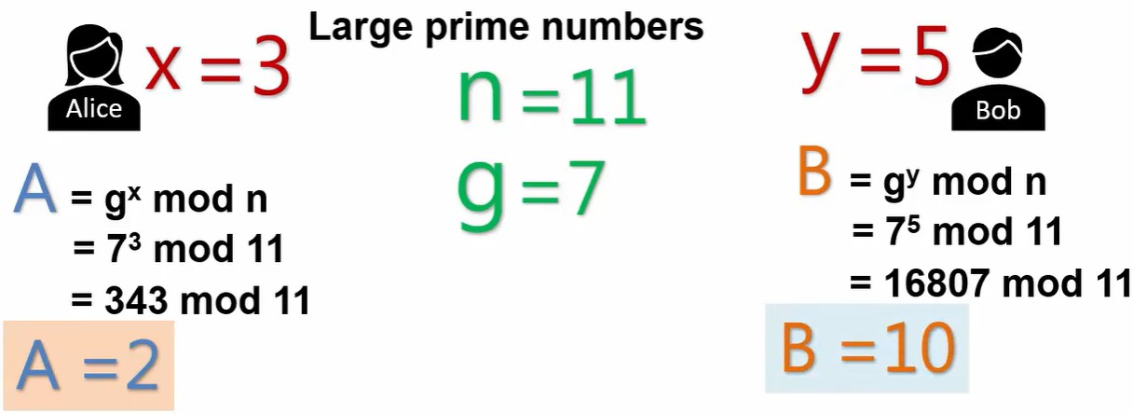
Each Side Computes a Public Value
With private values x = 3 and y = 5, Alice computes A = g^x mod n = 7^3 mod 11 = 2, and Bob computes B = g^y mod n = 7^5 mod 11 = 10. These public values are safe to exchange openly over the network.

Slide 33
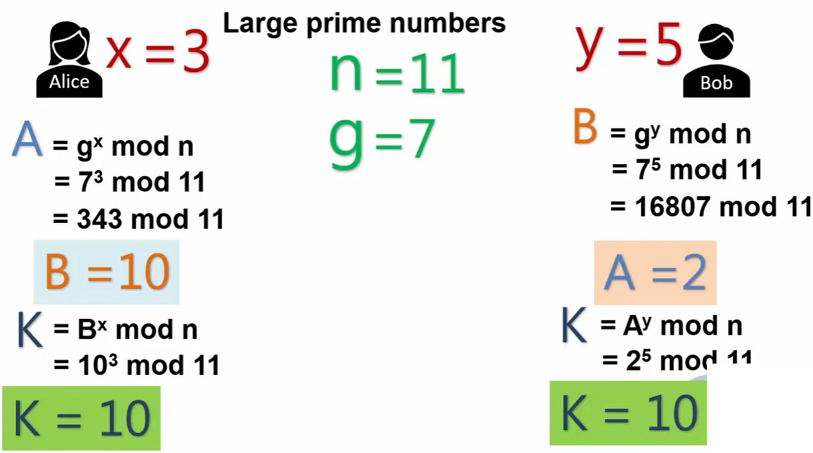
Both Sides Land on the Same Secret
Alice raises Bob's public value to her own private exponent: K = B^x mod n = 10^3 mod 11 = 10. Bob does the mirror calculation: K = A^y mod n = 2^5 mod 11 = 10. Without ever transmitting x, y, or K itself, both sides now hold an identical shared secret key.

Slide 34
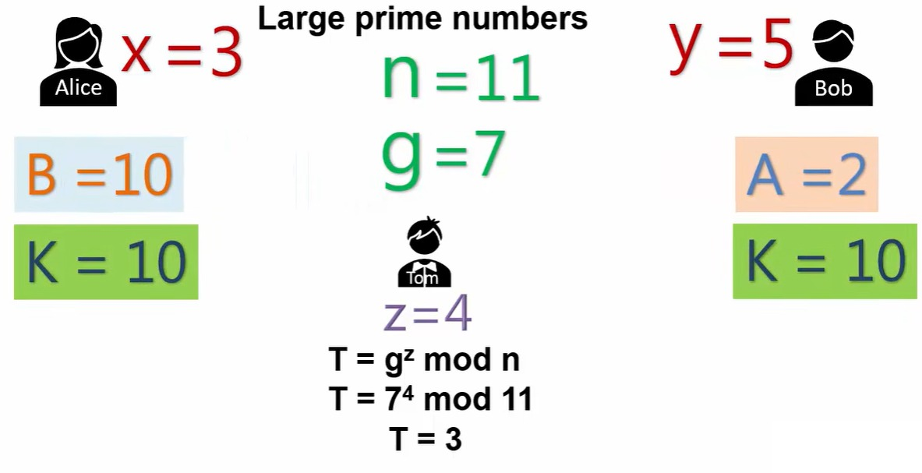
Enter Tom: An Attacker in the Middle
Tom secretly picks his own private value z = 4 and computes his own public value T = g^z mod n = 7^4 mod 11 = 3, ready to substitute himself for Alice and Bob without either one noticing.

Slide 35
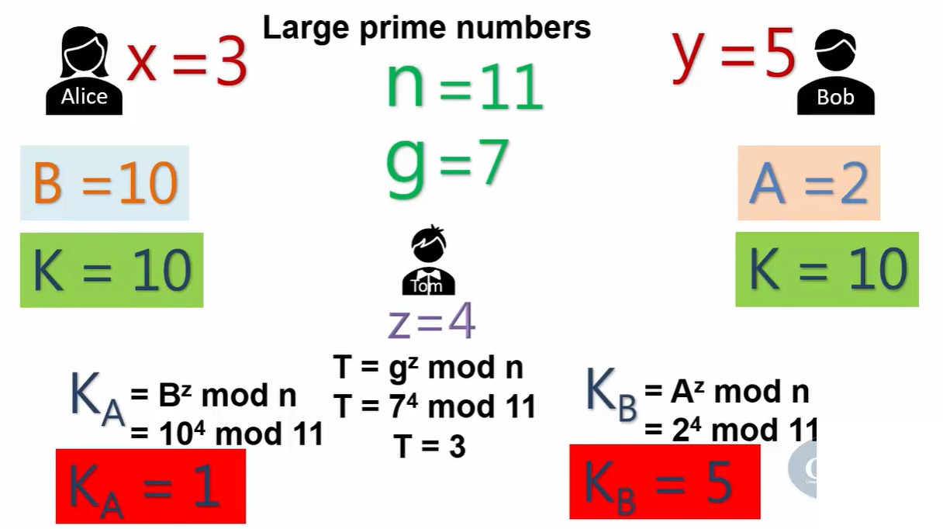
Two Secrets, Two Victims: The Break
Using Bob's real public value, Tom computes KA = B^z mod n = 10^4 mod 11 = 1 - the secret he now shares with Bob. Using Alice's real public value, he computes KB = A^z mod n = 2^4 mod 11 = 5 - the secret he shares with Alice. Tom relays traffic between them, decrypting with one key and re-encrypting with the other, while Alice and Bob believe they are still talking directly to each other.

Slide 36
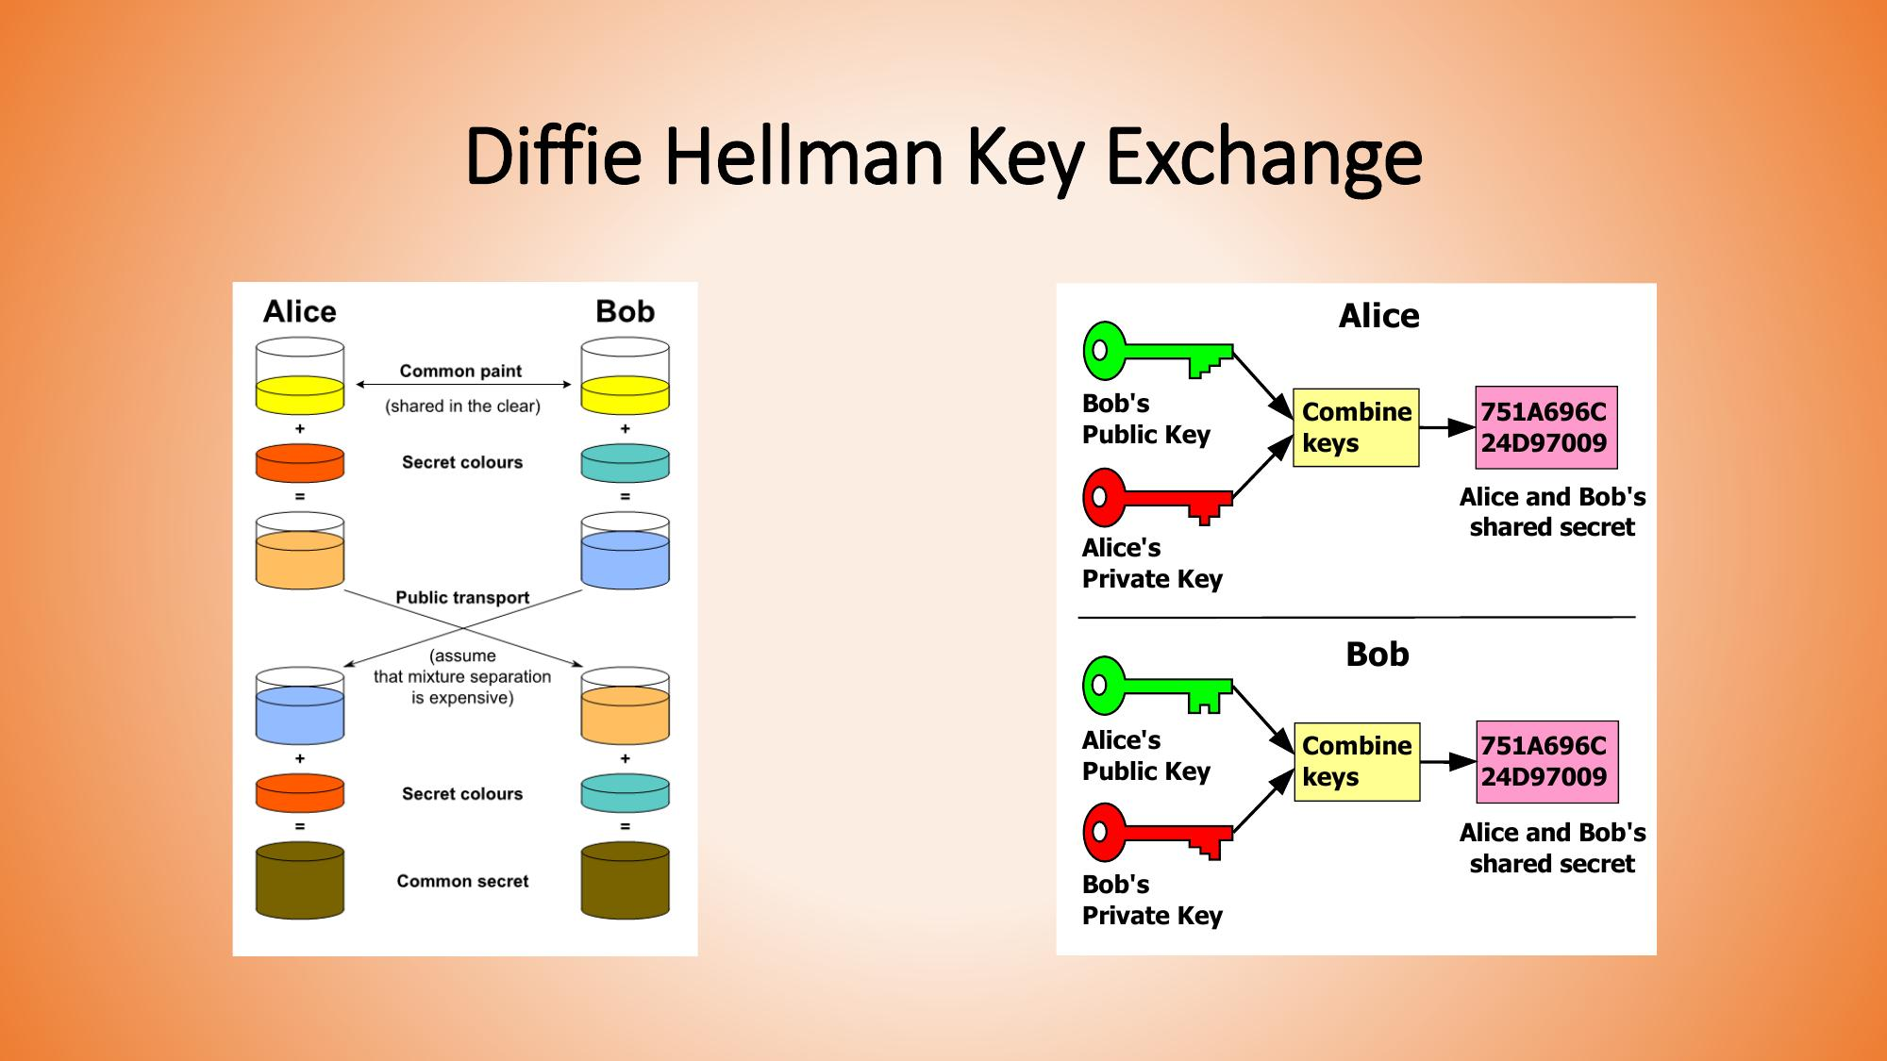

Slide 37
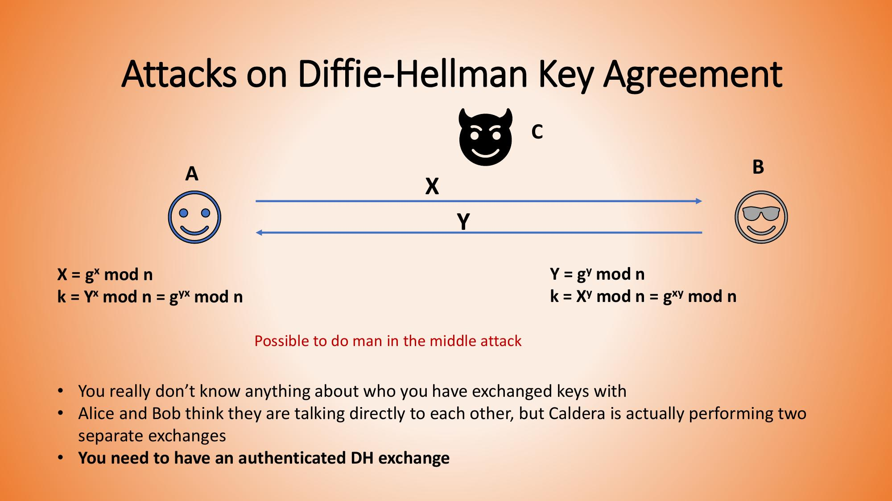

Slide 38
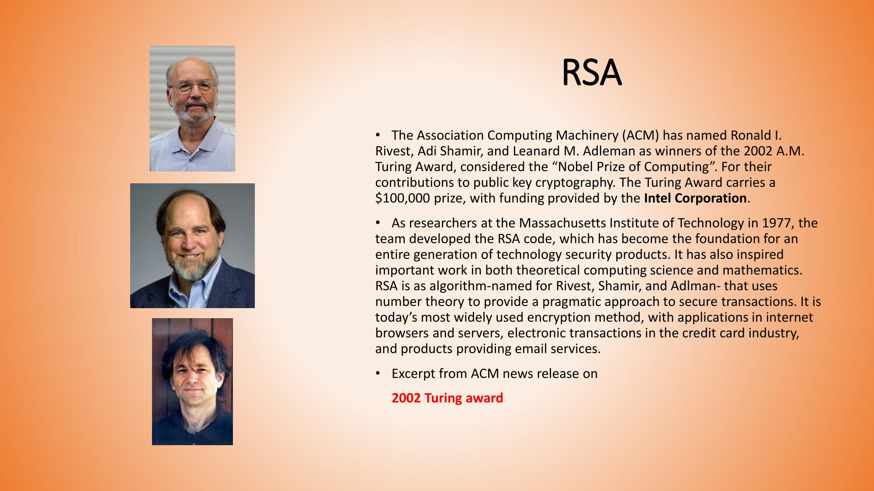

Slide 39
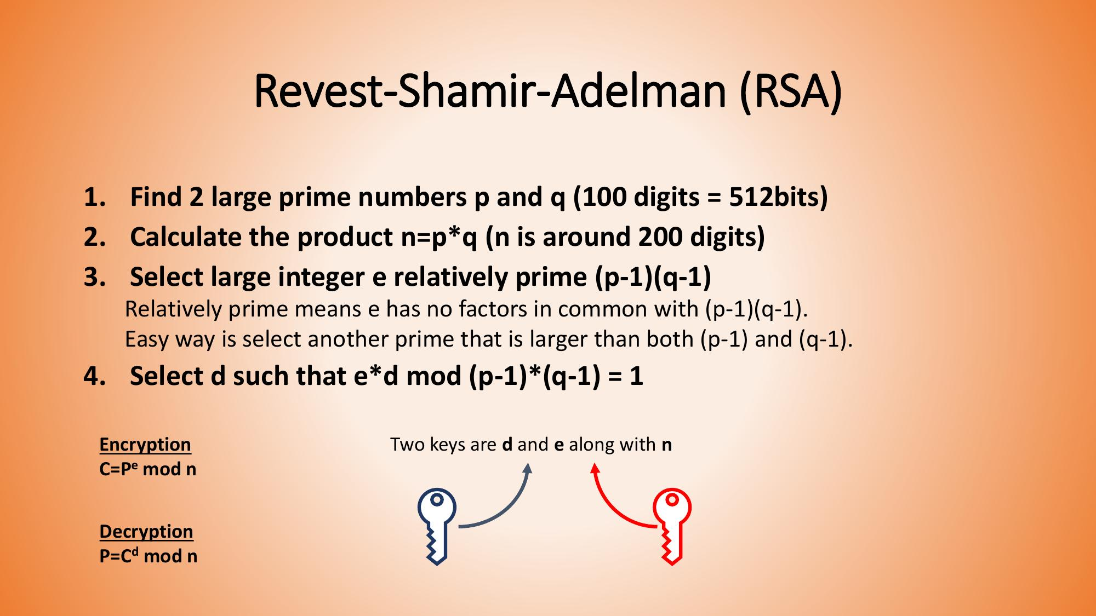

Slide 40
“Imagine Bob has a box. Bob gives everyone a key that can lock the box, but only Bob has the key that can unlock it.”
So:
🔓 Public Key = Lock the box
🔐 Private Key = Unlock the box
Anyone can use Bob's public key to send him a secret message.
Only Bob can use his private key to read it.

Slide 41
BOB
┌─────────────────┐
│ Public Key 🔓 │
│ Private Key 🔐 │
└─────────────────┘
↑
│
Public Key is shared
↓
ALICE
│
Secret Message
↓
Encrypt using Bob's
Public Key
↓
Encrypted Message
│
↓
BOB
│
Decrypt using his
Private Key
↓
Original Message
The public key can be shared. The private key must be kept secret.
That is the most important idea.

Slide 42
RSA creates the public key and private key using some mathematical steps
Use these six steps:
Choose two prime numbers: p and q
Calculate n = p × q
Calculate φ(n) = (p − 1)(q − 1)
Choose e
Calculate d
Form the keys
When selecting e,
Choose e between 1 and φ(n).
e must have no common factor with φ(n), except 1.
When selecting d,
d * e Mod φ(n) = 1
Step | Calculation
1 | Choose p, q
2 | n = p × q
3 | φ(n) = (p−1)(q−1)
4 | Choose e
5 | Find d
6 | Public Key = (e,n)
 | Private Key = (d,n)
Notes:
gcd(e,ϕ(n))=1
We could actually choose 7, 9, 11, 13, 17, or 19 too, because they are also relatively prime to 20.

Slide 43
Choose:
p = 3
q = 11
Step 1 — Calculate n
n=pq
n=3×11=33
So:
n = 33

Slide 44
Step 2 — Calculate Euler's Totient
ϕ(n)=(p−1)(q−1)
ϕ(n)=(3−1)(11−1)
=2×10=20
φ(n) = 20
Step 3 — Choose e
We need:
1<e<ϕ(n)
1<e<20 and
gcd(e,20)=1
Public Key
(e,n)=(3,33)
Notes:
1<e<20
gcd(e,20)=1

Slide 45
We need to find d such that:
D * e mod T = 1
T = ϕ(n)
7*3=21
21 mod 20 = 1
So:
Private Key
(d,n)=(7,33)

Slide 46
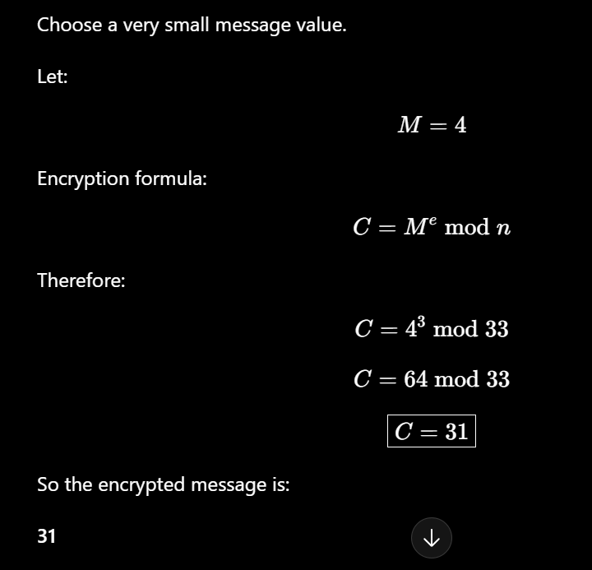

Encryption Formula

Slide 47
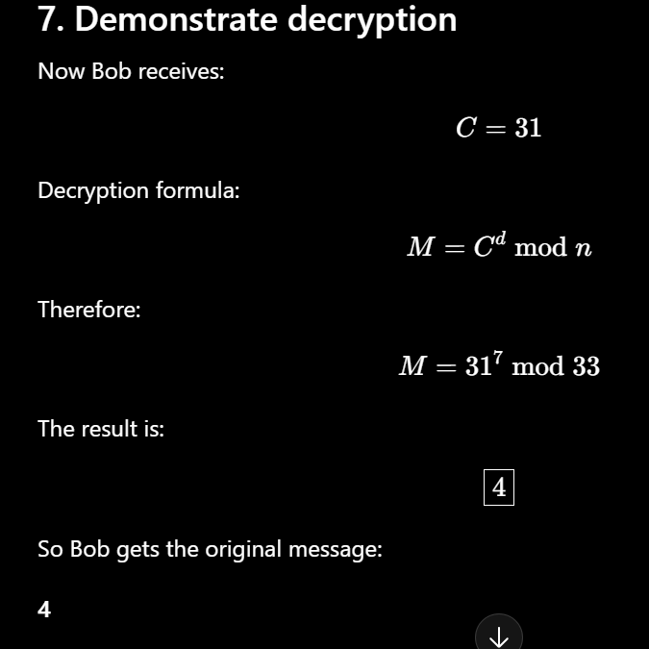

Decryption Formula

Slide 48
Further Study

Slide 49
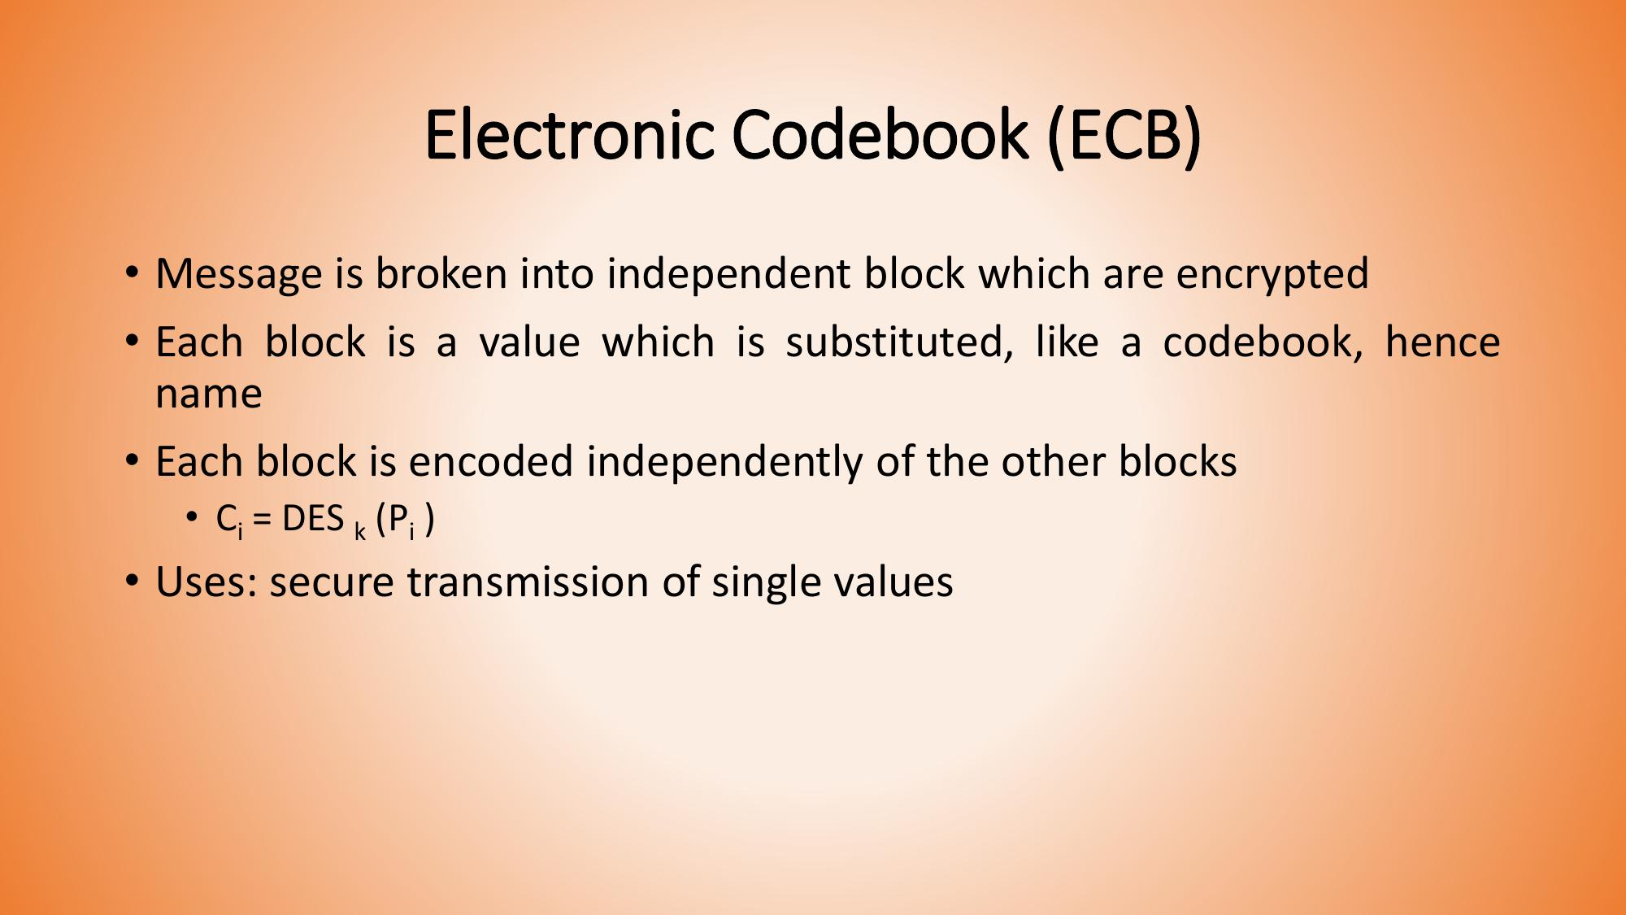

Slide 50
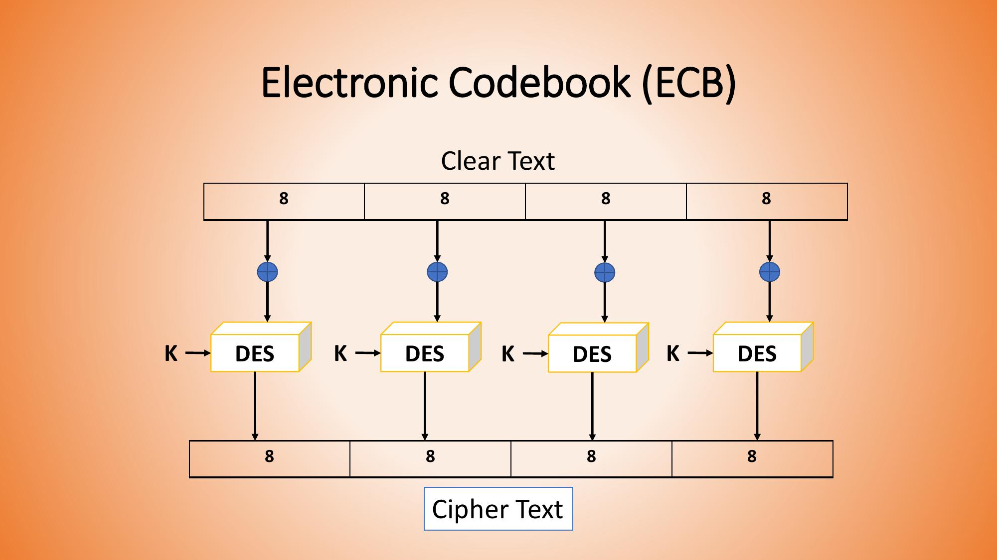

Slide 51
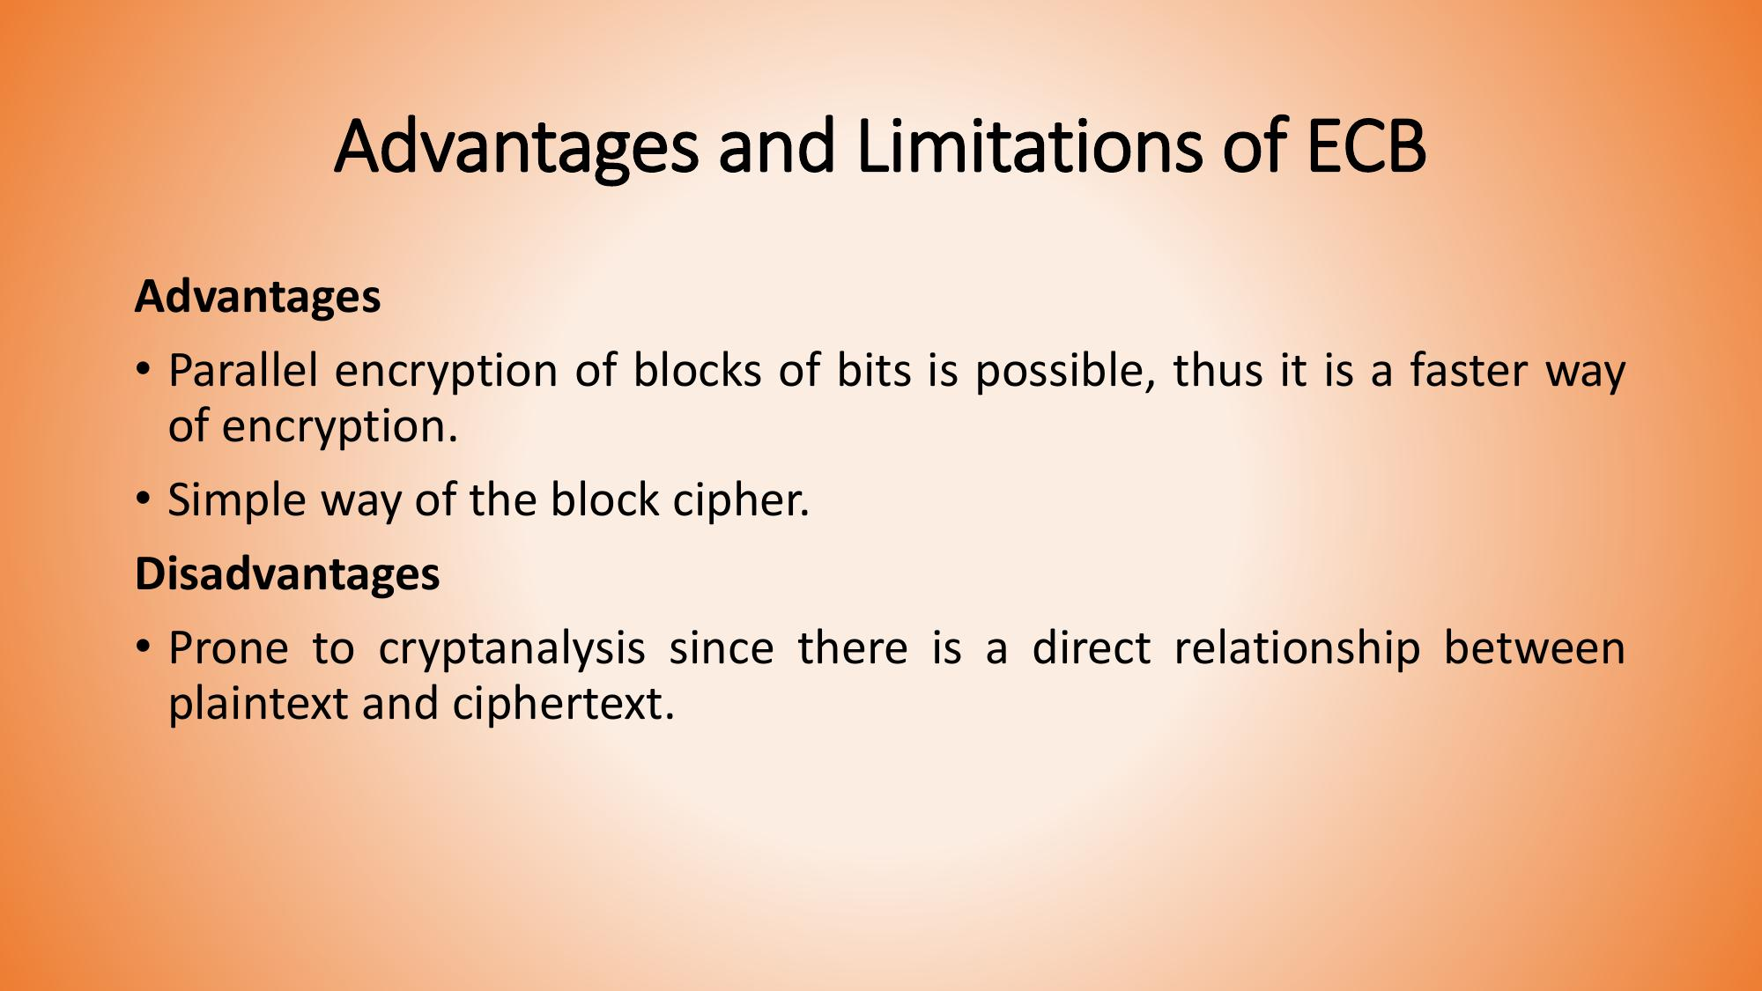

Slide 52
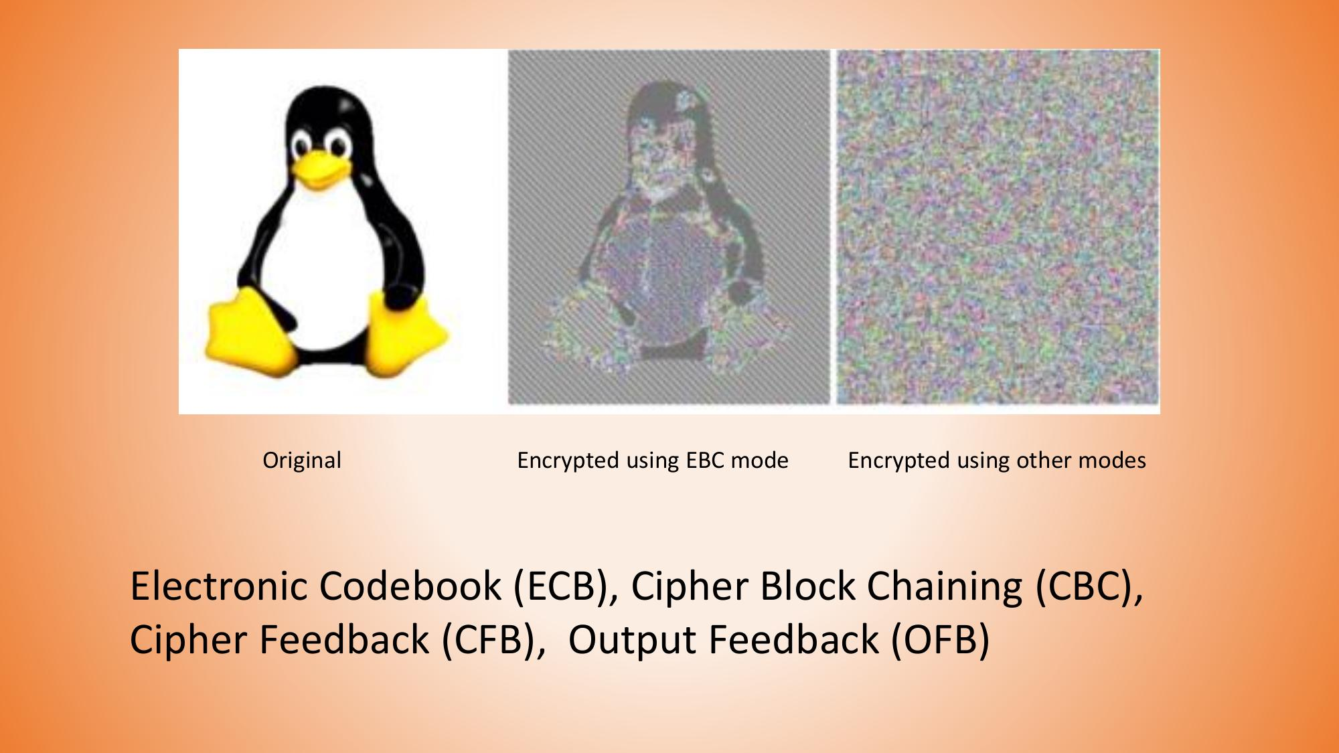

Slide 53
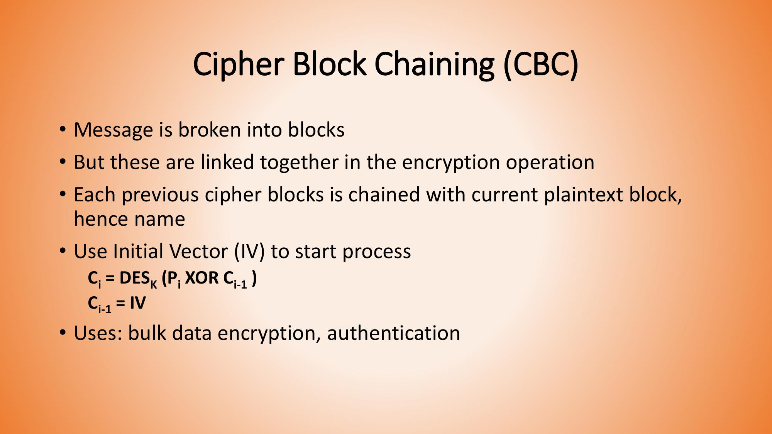

Slide 54
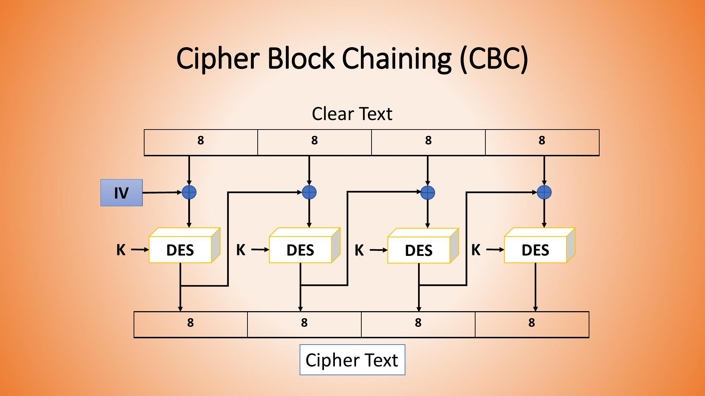

Slide 55
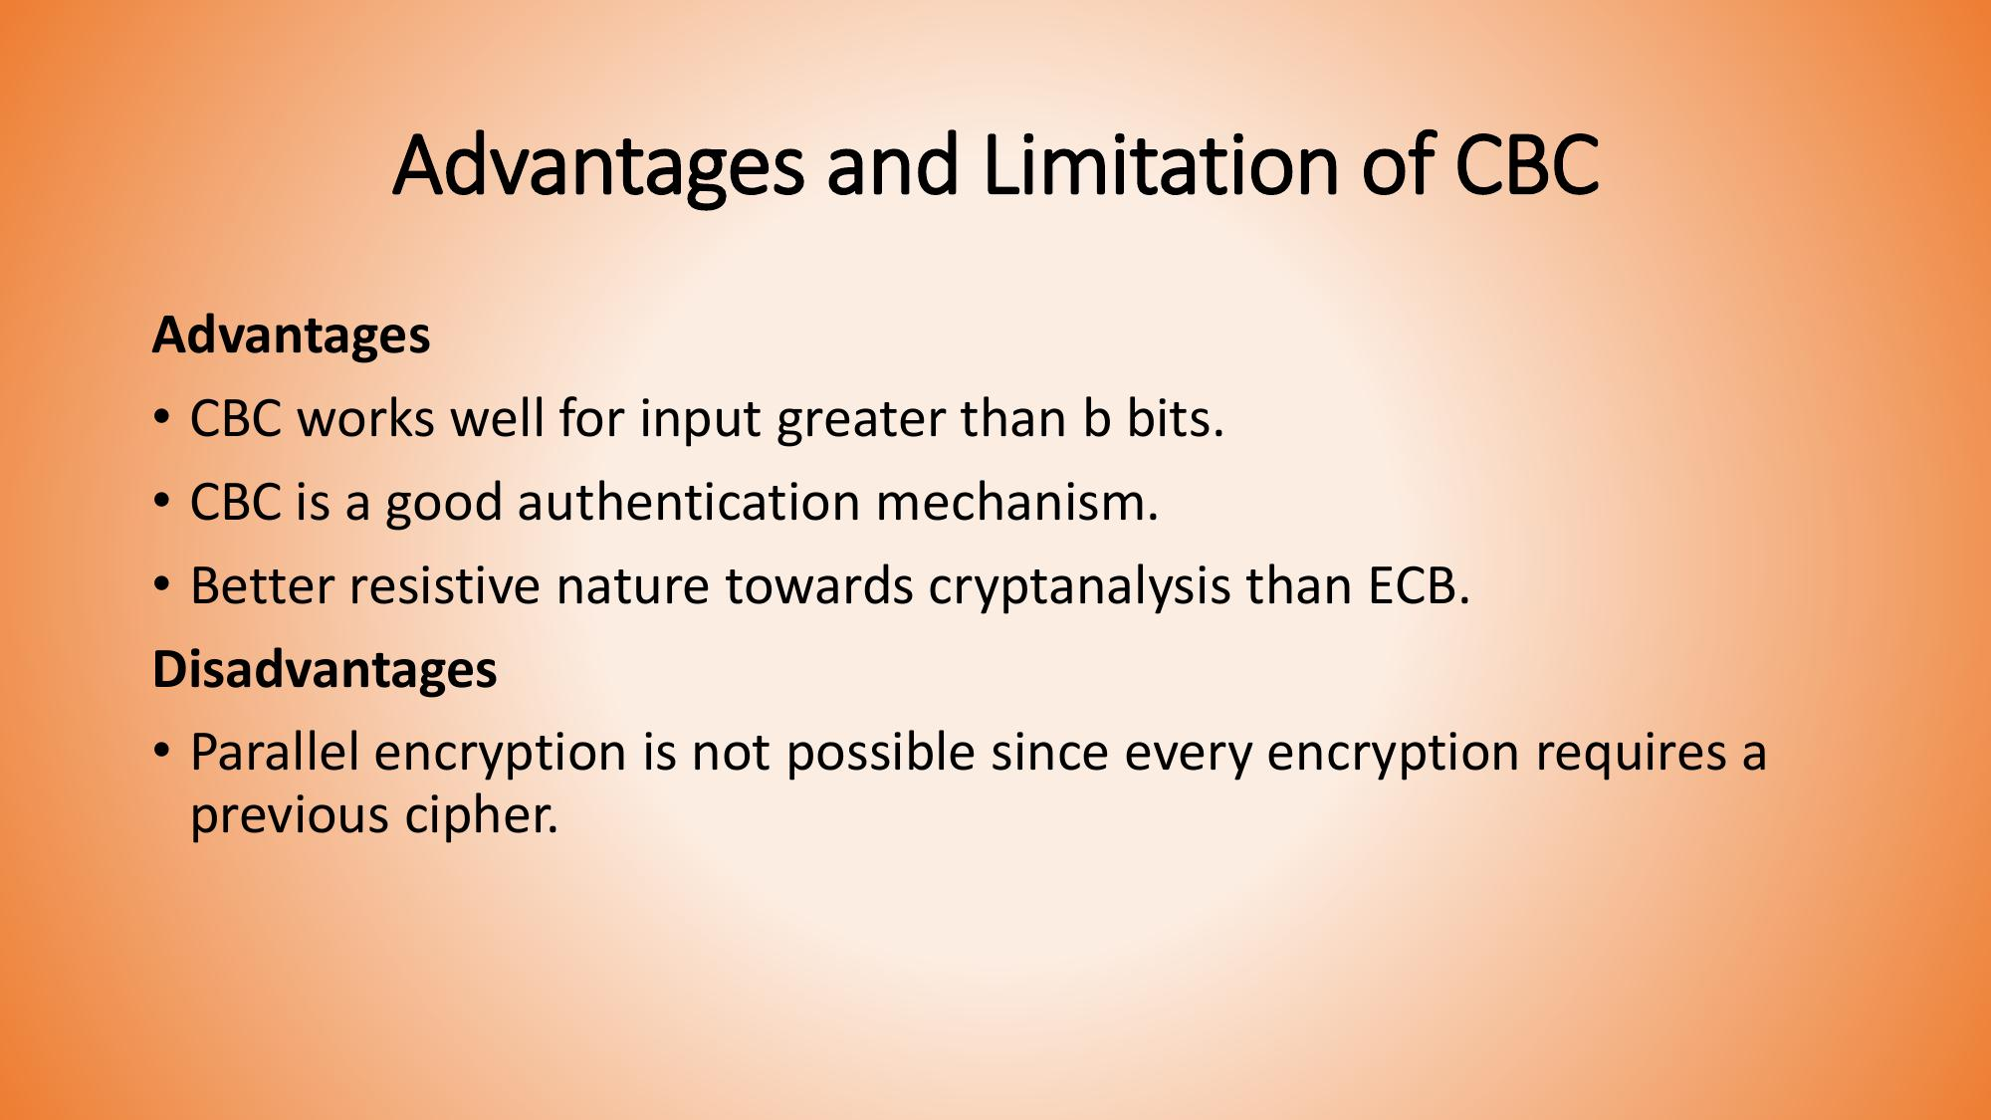

Slide 56
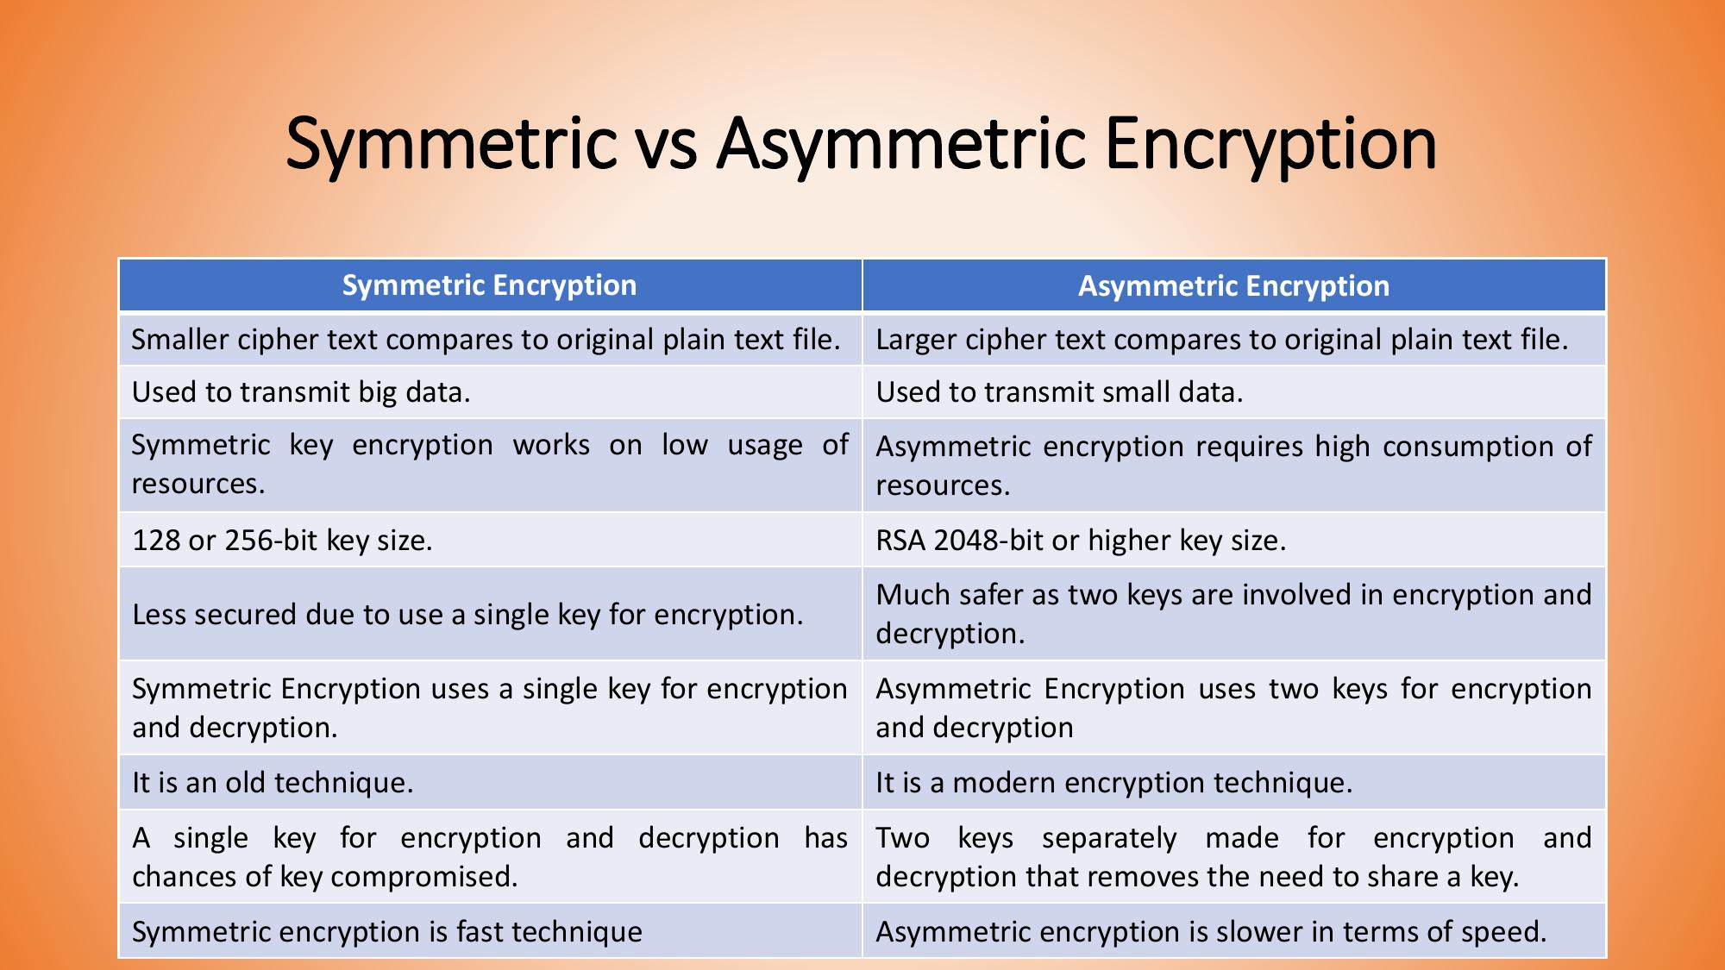

Slide 57


